Slide 1
Introduction to Robotics Course no. 3
Andrei Dumitriu
andrei.dumitriu@fmi.unibuc.ro
Faculty of Mathematics and Computer Science
University of Bucharest

Slide 2
Today’s plan
Getting started
Homework & Questions
Short recap Bigger recap from last course & lab
The button
Pullup, pulldown
INPUT_PULLUP
delay(), millis() and...what?
The what: interrupts

Slide 3
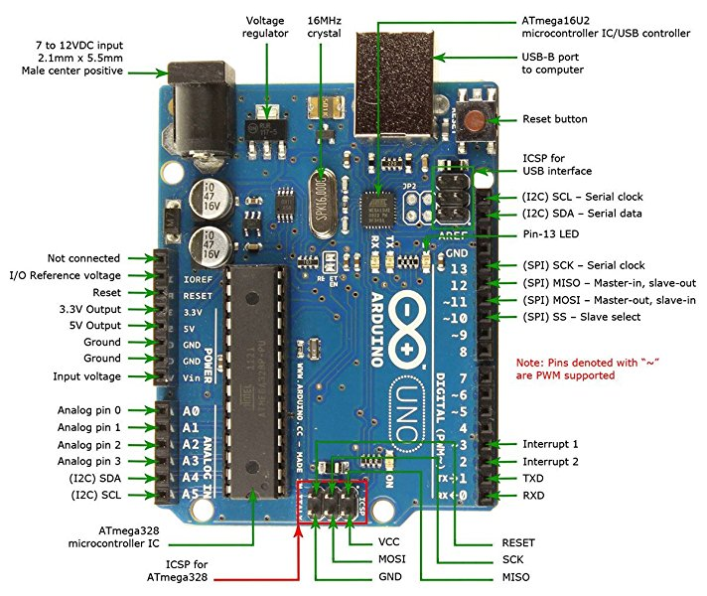
Arduino Uno board

Slide 4
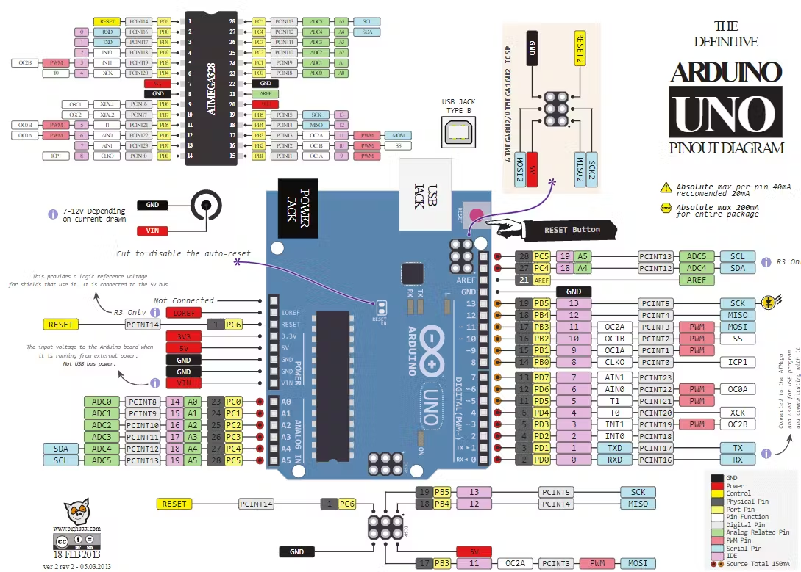
Arduino Uno board

Slide 5
Basic Notations
VCC - Voltage Common Collector = the voltage of the source
GND - Ground = the reference value for the current in the circuit (in our case)
For more details of different types of ground check the following article:
https://www.autodesk.com/products/fusion-360/blog/how-does-ground-work-in-electronics/
Ax (e.g. A0) - analogic pin
Dx (e.g.D12) - digital pin

Slide 6
Basic Functions
analogRead(): Read the value from an analog pin.
analogWrite(): Output a PWM signal.
digitalRead(): Read the value from a digital pin.
digitalWrite(): Set a digital pin to HIGH or LOW.
pinMode(): configure the pin as either INPUT or OUTPUT

Slide 7
Point of view - Signal
A signal might have 2 interpretations:
input
it gives information to the system
it is commonly called a reading
output
it gives information to the outside of the system
These interpretations can also be of 2 types:
digital
analog

Slide 8
Logical interpretation
Digital signals have 2 states:
a HIGH/ON state
a LOW/OFF state
The state depends on the voltage received.
The levels of voltage correlated to a state are standardized.
Two of the most common standards are:
TTL Logic Levels
CMOS Logic Levels

Slide 9
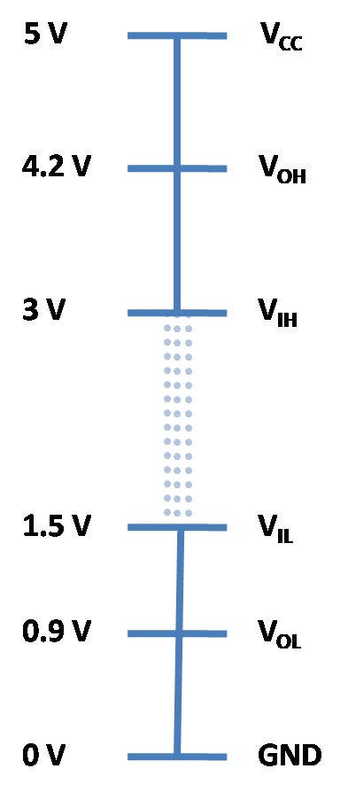
Arduino logic levels

Slide 10
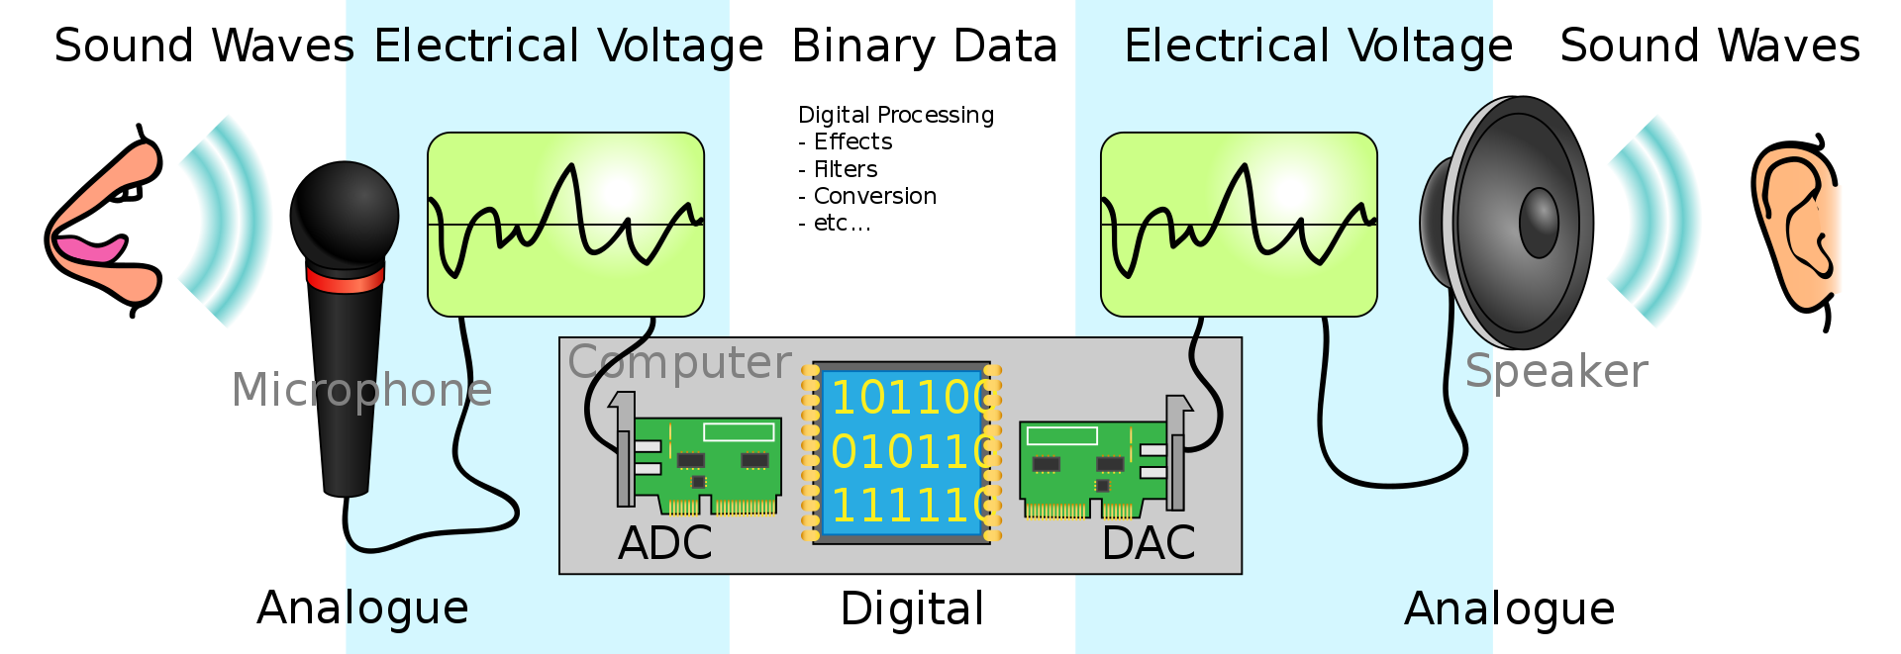
Electrical signals
Digital signal
Analog signal
Source

Slide 11
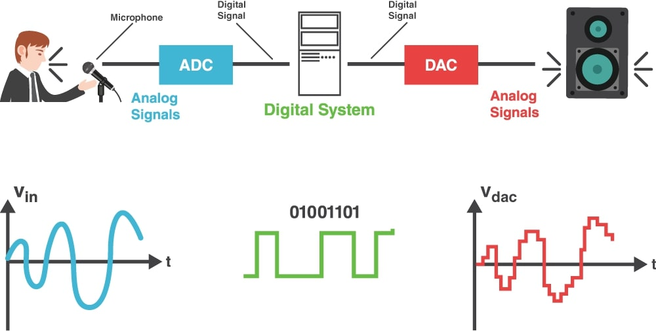
Electrical signals
Digital signal
Analog signal
Source

Slide 12
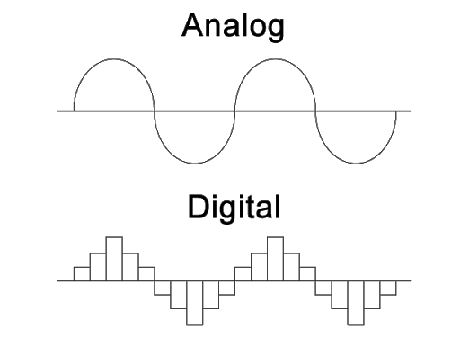
Data representation
Interpolation
Sampling
Quantization

Slide 13
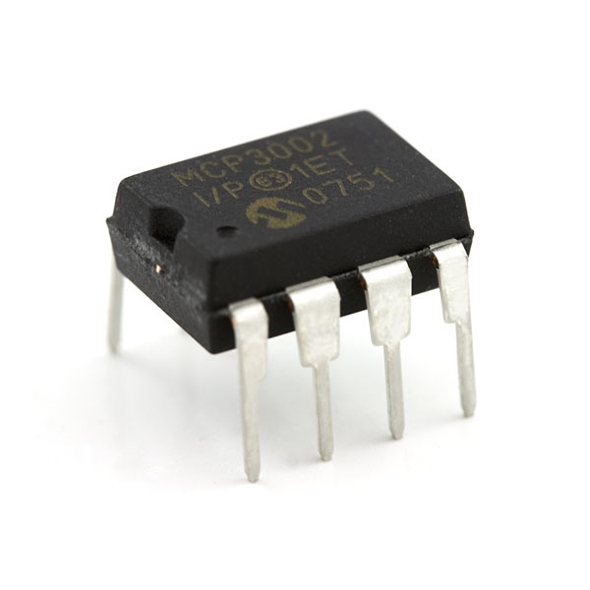

Converters
Electrical integrated solutions
Analog to Digital Converter (ADC)
Digital to Analog Converter (DAC)
Does the Arduino Uno board have converters integrated?

Slide 14
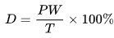
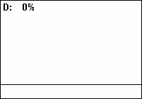
PWM (pulse-width modulation)
A duty cycle or power cycle is the fraction of one period in which a signal or system is active. Duty cycle is commonly expressed as a percentage or a ratio. A period is the time it takes for a signal to complete an on-and-off cycle. As a formula, a duty cycle (%) may be expressed as:
where D is the duty cycle, PW is the pulse width (pulse active time), and T is the total period of the signal. Thus, a 60% duty cycle means the signal is on 60% of the time but off 40% of the time. The "on time" for a 60% duty cycle could be a fraction of a second, a day, or even a week, depending on the length of the period.
Then, to calculate the output voltage, we have
V_dac = D * V
where D is the duty cycle and V is the signal Voltage
https://en.wikipedia.org/wiki/Duty_cycle

Slide 15

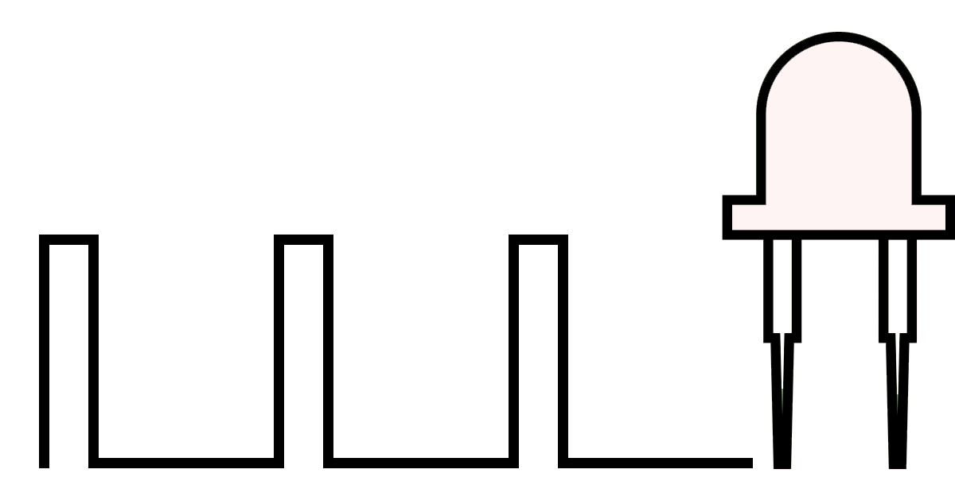
PWM (pulse-width modulation)
A technique for getting analog results with digital means
*gif works if you open the .ppt. It is possible to do so in the browser.

Slide 16
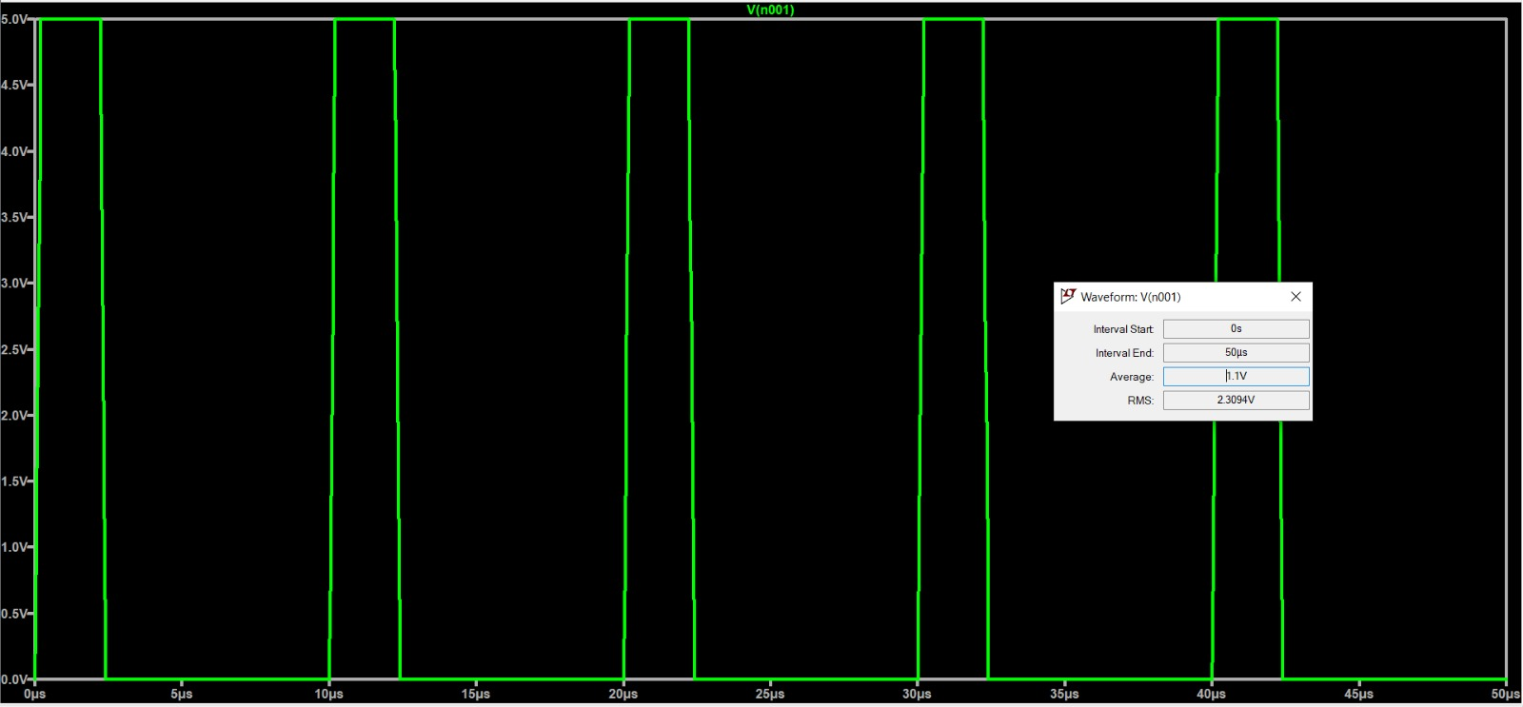
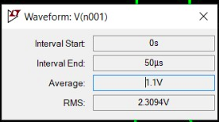
The voltage supply is 5V.
The duty cycle is 20% (Pulse width is 2u sec, and the period is 10u sec).
The output average should be 20*5/100 = 1 V.
Why is the average 1.1V ?

Slide 17
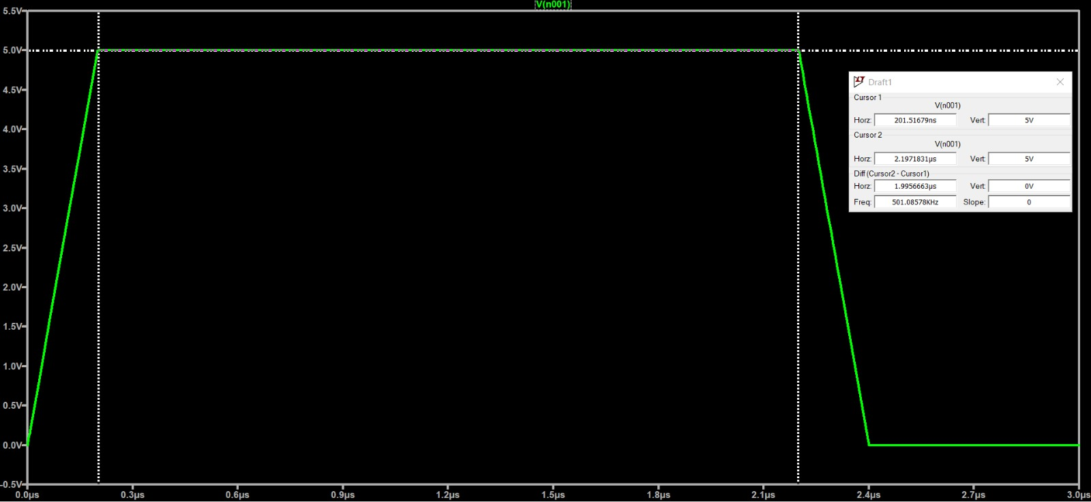
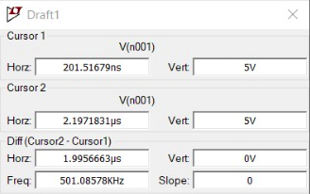
The rising and falling time are not 0.
The pulse is not a perfect square wave.
The areas under the slopes will be add to the average voltage.

Slide 18
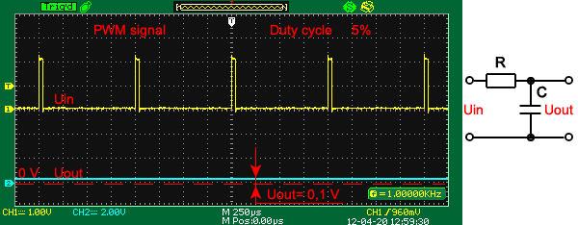
PWM (pulse-width modulation)
In practice, we use a RC low pass filter to convert the square wave into a continuous analog voltage (bottom line)
Detailed explanation
*gif works if you open the .ppt. It is possible to do so in the browser.

Slide 19
PWM and timers
Arduino Uno has 3 timer:
Timer0:
8-bit timer
Used for the millis() and delay() functions
Connects to PWM pins 5 and 6
Timer1:
16-bit timer
Connects to PWM pins 9 and 10
Timer2:
8-bit timer
Connects to PWM pins 3 and 11
Example:
When you execute the command “analogWrite(9, 127);” on an Arduino Uno:
You're using Timer1.
You're setting the duty cycle to approximately 50% (because 127 is roughly half of 255, the maximum value for 8-bit PWM).
Timer1 updates the output voltage on pin 9 at regular intervals to generate the PWM waveform.
*gif works if you open the .ppt. It is possible to do so in the browser.

Slide 20
PWM and timers
How the Timer Actually Generates PWM:
The timer continuously counts from 0 up to its maximum value (255 for 8-bit timers, 65535 for 16-bit Timer1).
A comparison value is set based on your analogWrite() value (0-255).
As the timer counts, it compares its current count with this comparison value.
The output pin is set HIGH when the timer count is 0.
The output pin is set LOW when the timer count matches the comparison value.
This creates the PWM waveform, with the duration of the HIGH state determined by the comparison value, thus setting the duty cycle.
Caveats:
Since the timers are used for multiple purposes (like millis() and delay() functions on Timer0), directly manipulating a timer's registers for custom PWM can affect these functions. Always consider potential conflicts when delving deep into timer manipulation.
Careful: many functions can use the timers, disrupting the PWM ability of some pins. Two of those functions, which you will user, are tone() and servo().
*gif works if you open the .ppt. It is possible to do so in the browser.

Slide 21
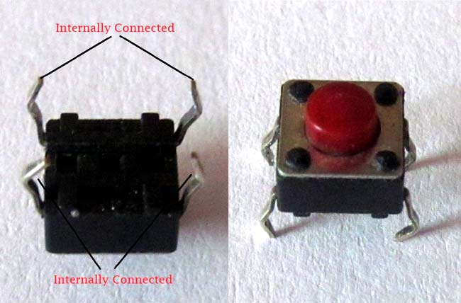
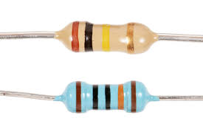
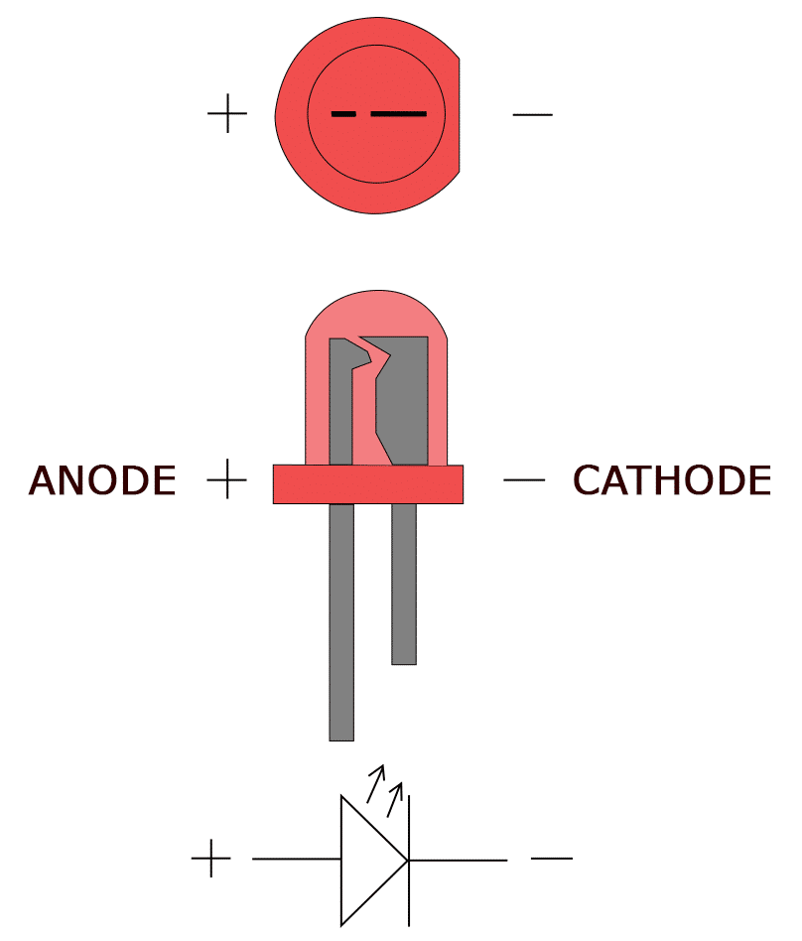
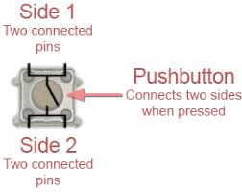
Simple electronic components
LED Push button Resistor
Resistors are electrical components used to limit current in a circuit. They are passive components, meaning they only consume power (and can't generate it). The resistor's resistance limits the flow of electrons through a circuit.

Slide 22
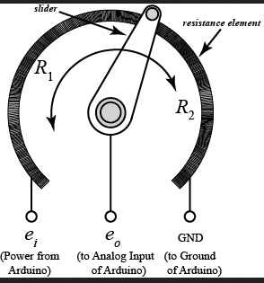
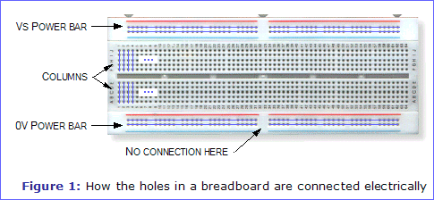
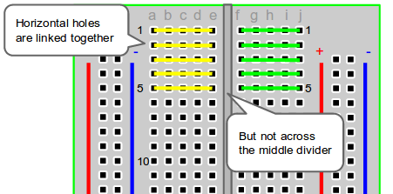
Simple electronic components
Breadboard Potentiometer
A potentiometer is a simple knob that provides a variable resistance, which we can read into the Arduino board as an analog value.

Slide 23
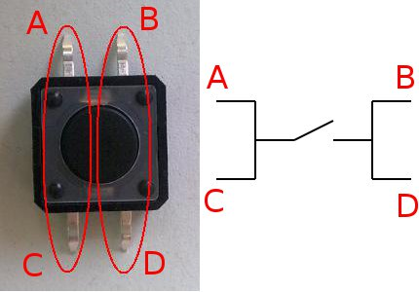
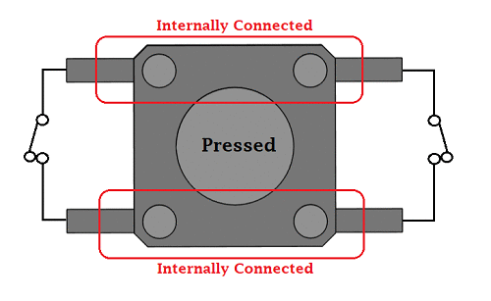
The infamous PUSHBUTTON

Slide 24
Pushbutton
OK, but how do we use it?
How do we connect it?
What values will we read from it?

Slide 25
Pushbutton
In digital electronics, 0 and 1 are used to transmit data, and since you cannot send a number 0 or 1 through a cable, voltage values ​​are used to indicate each of the states.
For the HIGH or 1 state a value of 5v will be used, and for LOW or 0 a value of 0v will be used.

Slide 26
Pushbutton
So we can basically have the button between 5V and a pin. When the button is pressed, the pin reads 5V (HIGH). When it is not pressed…what will it read?
What does a digitalRead(pin) return, if nothing is connected to it?

Slide 27
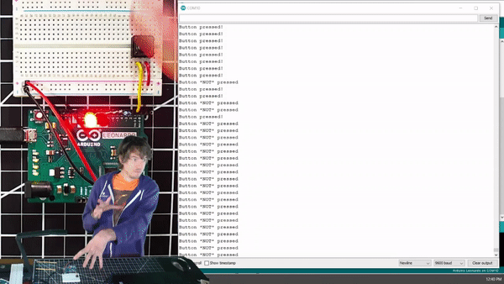
Pushbutton

Slide 28
Pushbutton
So we can basically have the button between 5V and a pin. When the button is pressed, the pin reads 5V (HIGH). When it is not pressed…what will it read?
What does a digitalRead(pin) return, if nothing is connected to it?
It will fluctuate and it is called a floating pin.
Solution?

Slide 29
Pushbutton
So we can basically have the button between 5V and a pin. When the button is pressed, the pin reads 5V (HIGH). When it is not pressed…what will it read?
What does a digitalRead(pin) return, if nothing is connected to it?
It will fluctuate and it is called a floating pin.
Solution? Pullup or pulldown the floating pin value, by connecting it to ground or 5V. But how do you change it? Let’s draw the circuits.

Slide 30
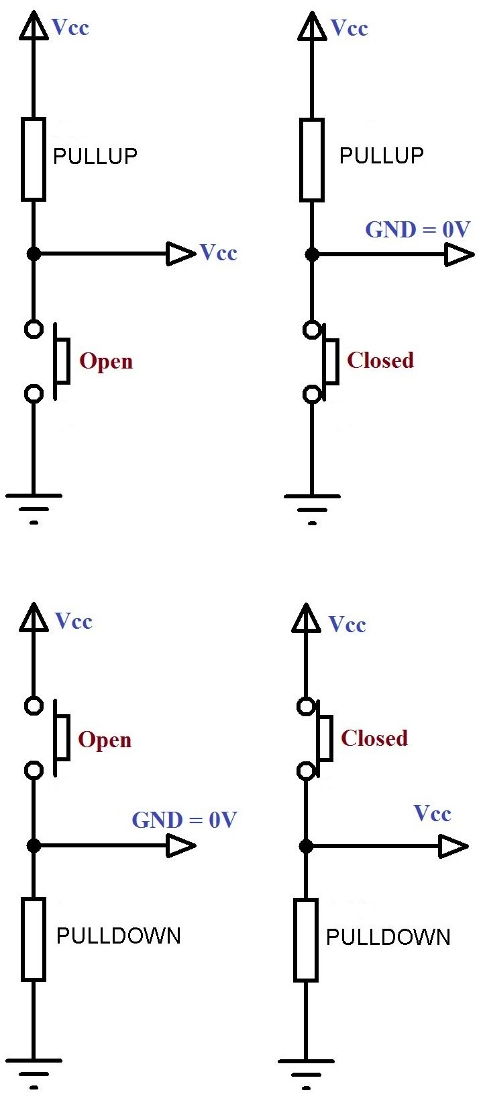
Pushbutton
Can be used with a PULLUP or PULLDOWN resistor
For PULLDOWN the default (not pressed) value will be 0 and the pressed value will be 1
For PULLUP it is the opposite: the default (not pressed) value will be 1 and the pressed value will be 0

Slide 31
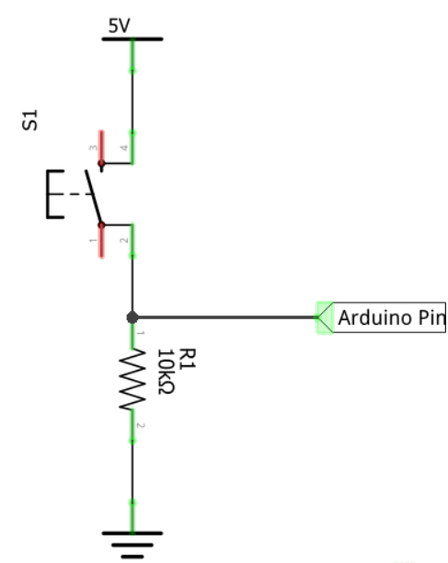
Pushbutton - pulldown resistor
A pull-down resistor is not a special resistor. In this case this resistance is connected to 0v (GND), so by default it will have a LOW state.
When the button is pressed, our pin will change from a LOW state to a HIGH state.
What’s with the resistor?

Slide 32
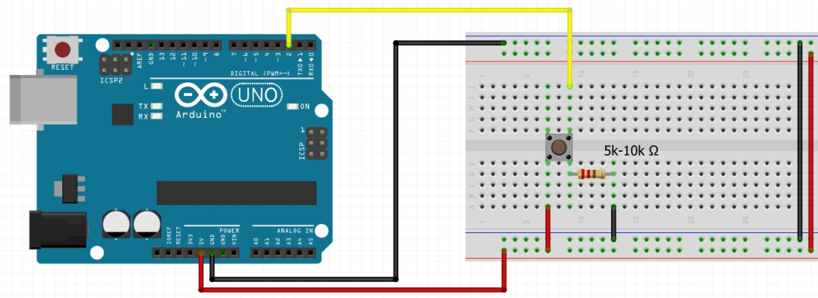
Pushbutton - pulldown resistor

Slide 33
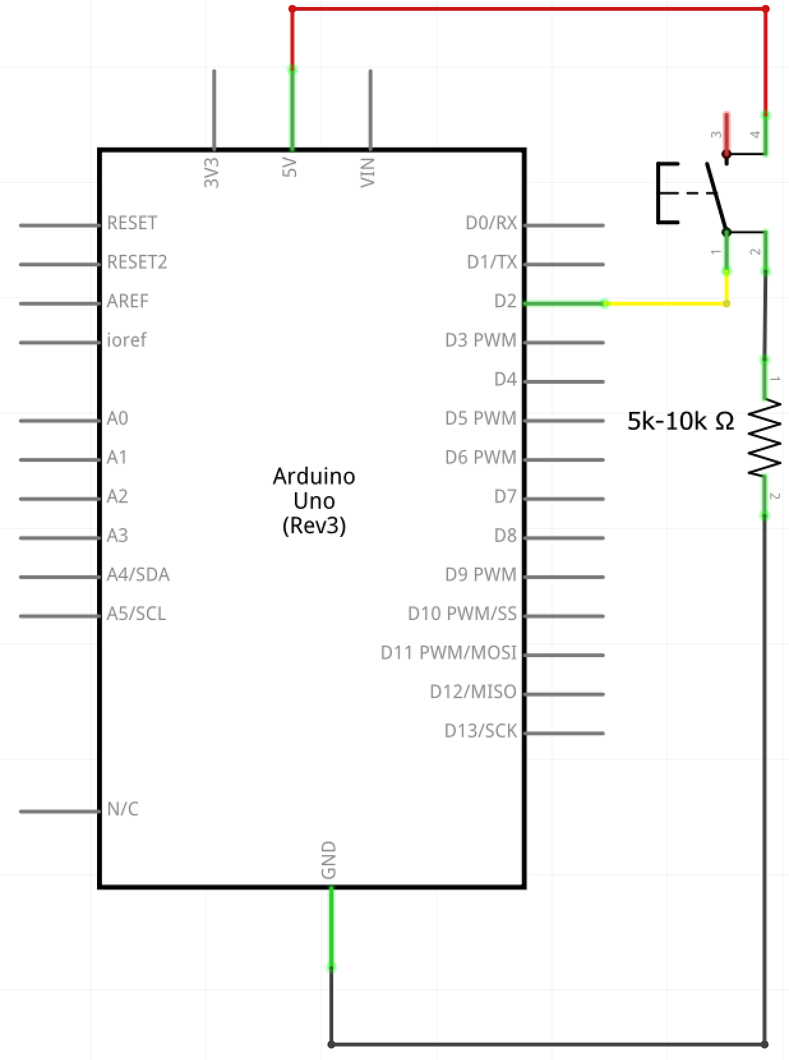
Pushbutton - pulldown resistor

Slide 34
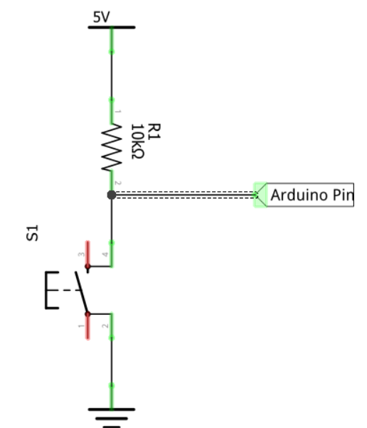
Pushbutton - pullup resistor
In the case of the pull-up resistor, the Arduino pin is connected to 5v or 3.3v through a resistor.
This causes that by default it has a HIGH value, and when we connect it to 0v by pressing the button, it will have a LOW state.
Why do we need the resistor, then?

Slide 35
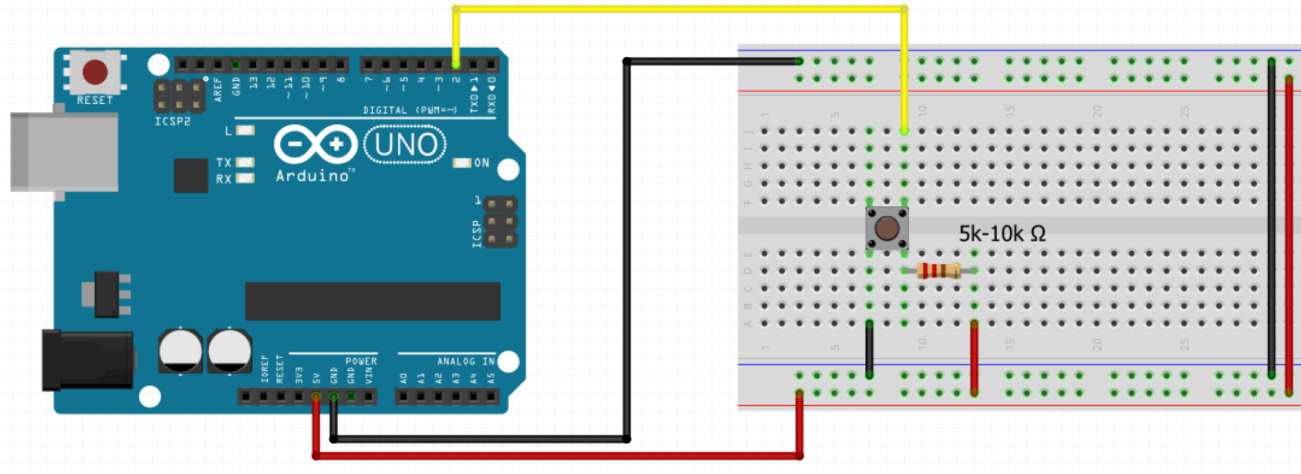
Pushbutton - pullup resistor

Slide 36
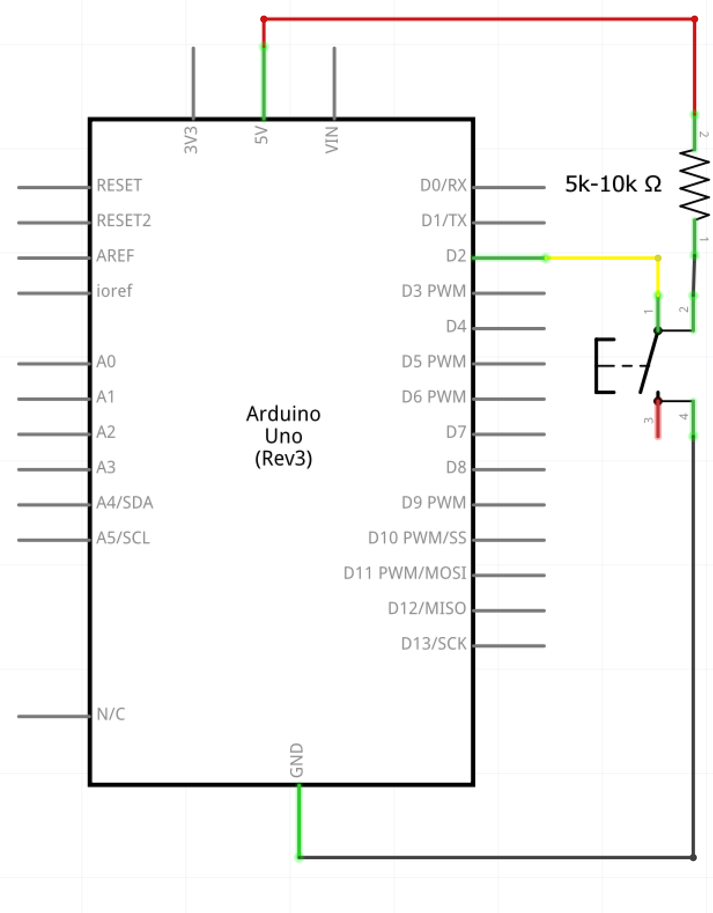
Pushbutton - pullup resistor

Slide 37
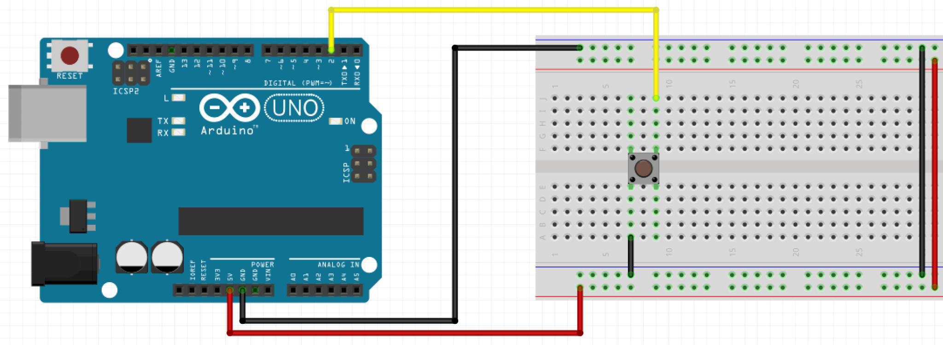
Internal pullup
You enable it by using INPUT_PULLUP instead of INPUT on pinMode
pinMode(buttonPin, INPUT_PULLUP)
The pin is pulled to 5V with a 20K-ohm resistor. This configuration causes the input to read HIGH when the switch is open, and LOW when it is closed.

Slide 38
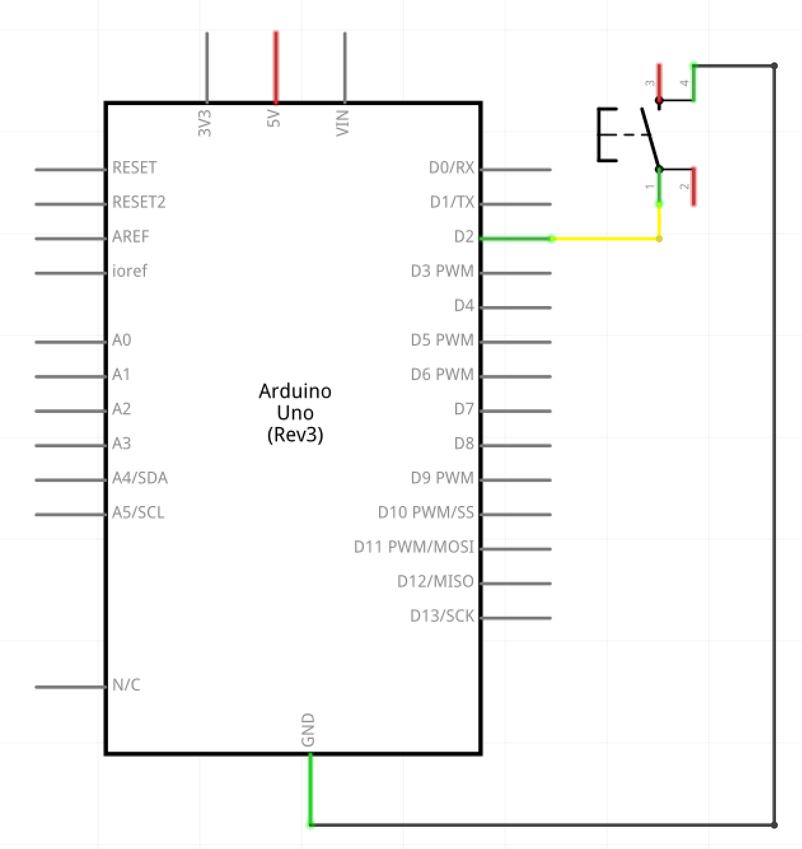
Internal pullup

Slide 39
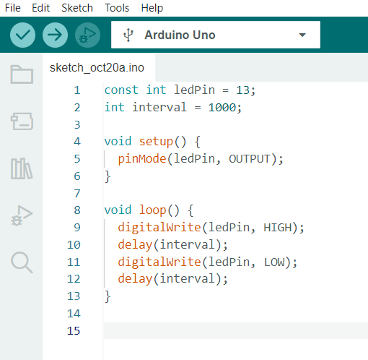
delay()
Last time we did a blinking LED with delay.
Fine and simple, but what was the problem with that?
What’s the solution?

Slide 40
delay() and millis()
Let’s imagine cooking: you want to cook a pizza that needs to stay 40 minutes in the oven. What would be delay(), what would be millis() - based approach?

Slide 41
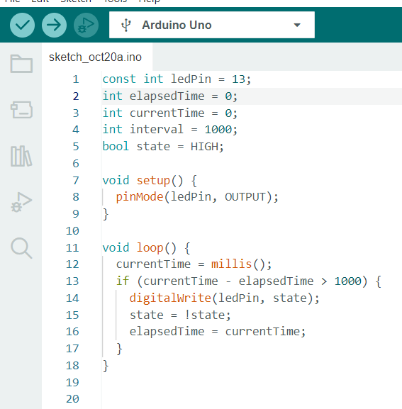
millis()
Enter millis()
“Returns the number of milliseconds passed since the Arduino board began running the current program. This number will overflow (go back to zero), after approximately 50 days.”
source: https://www.arduino.cc/reference/en/language/functions/time/millis/

Slide 42
Delay(), millis() and ...what?
Let’s go back to the cooking analogy. What would be another way to do things?

Slide 43
Interrupts
We’ve all been interrupted. Just like you’re looking at your phone when it rings instead of continuing what you do.
There are 2 types of interrupts:
external
timer
How does this related to microcontrollers?

Slide 44
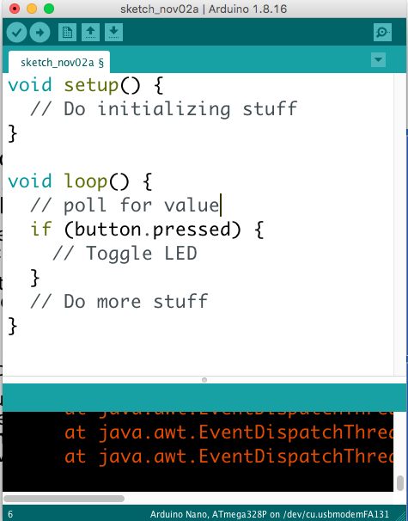
Super-loop and polling
In arduino (and on many controllers) we use a programing architecture / scheme called super-loop:
we run a piece of code only once, to set the pins etc - setup
then we enter an while loop that runs forever, called a super loop
an endless loop is usually considered bad practice on a computer. On a microcontroller, it’s pretty normal
in a basic super-loop structure, we might check to see if a button is pressed. This is called polling, as we poll - or check - to see if our event has occurred

Slide 45
Interrupts
Polling is pretty simple to do, and often all you need.
However, although we saw ways of avoiding delay() with millis() - what if the delay() is caused by all the instructions you have to run?
To solve this, we can use interrupts

Slide 46
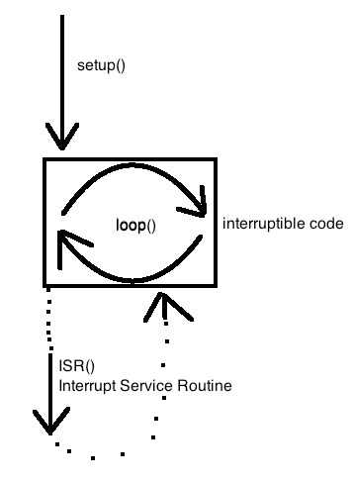
Interrupts
Interrupts, in arduino, work the following way
in setup, we tell the processor that we are open to interrupts (it is open by default in Arduino)
from then on, whenever a button push is detected, the program stops whatever it is doing and executes the interrupt
we tell the microcontroller how to do this by writing a special function, an ISR() - Interrupt Service Routine
it is not doing two things at the same time: the program stops, saves any information it might need, goes and executes the interrupt, returns, loads the data and continues

Slide 47
Interrupts
In arduino, we use the function attachInterrupt(interruptNumber, ISR(), STATE)
interruptNumber - this is the interrupt number, not the same as the pin
ISR() - the function that is called
STATE - on which state to call the interrupt
https://www.arduino.cc/reference/en/language/functions/external-interrupts/attachinterrupt/

Slide 48
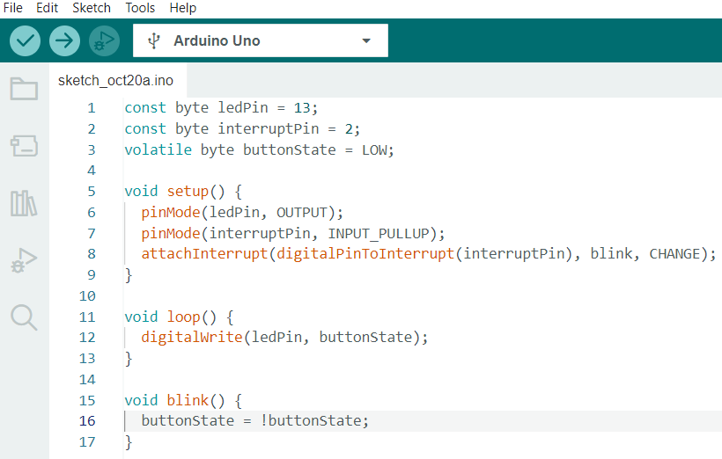
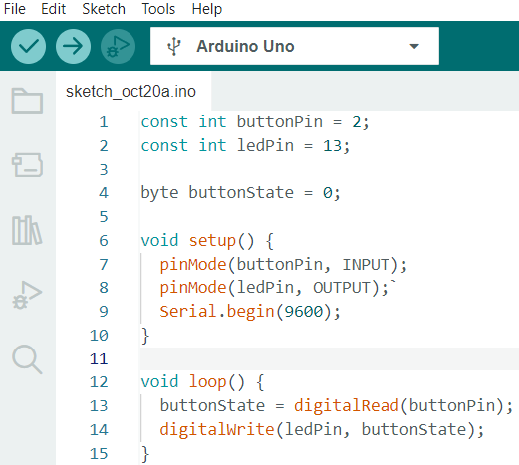
Interrupts vs Polling

Slide 49
Links
Super-loop architecture: https://en.wikibooks.org/wiki/Embedded_Systems/Super_Loop_Architecture
https://www.electronics-tutorials.ws/logic/pull-up-resistor.html
https://pijaeducation.com/basic-electronics/electronic-components-and-circuits/section-b/pull-up-resistor-and-pull-down-resistor/
https://pijaeducation.com/basic-electronics/computing/ttl-logic-levels/
https://en.wikipedia.org/wiki/Multiplexing

Slide 50
Attendance check
Who’s missing?

